Slide 1
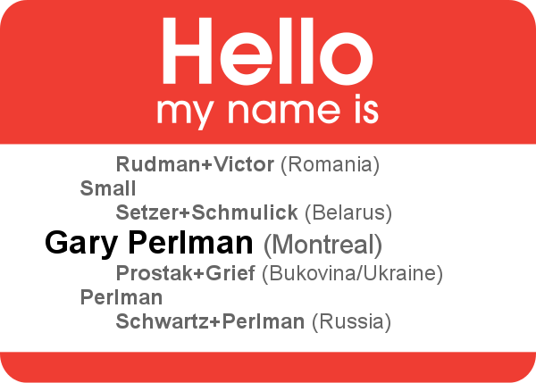
How Volunteer Genealogy
Improved my Research Skills, Strengthened My Family Relations, and Created New Tools
Gary Perlman
Webmaven
JGS-Montreal.org
gary@perlman.ca

Slide 2
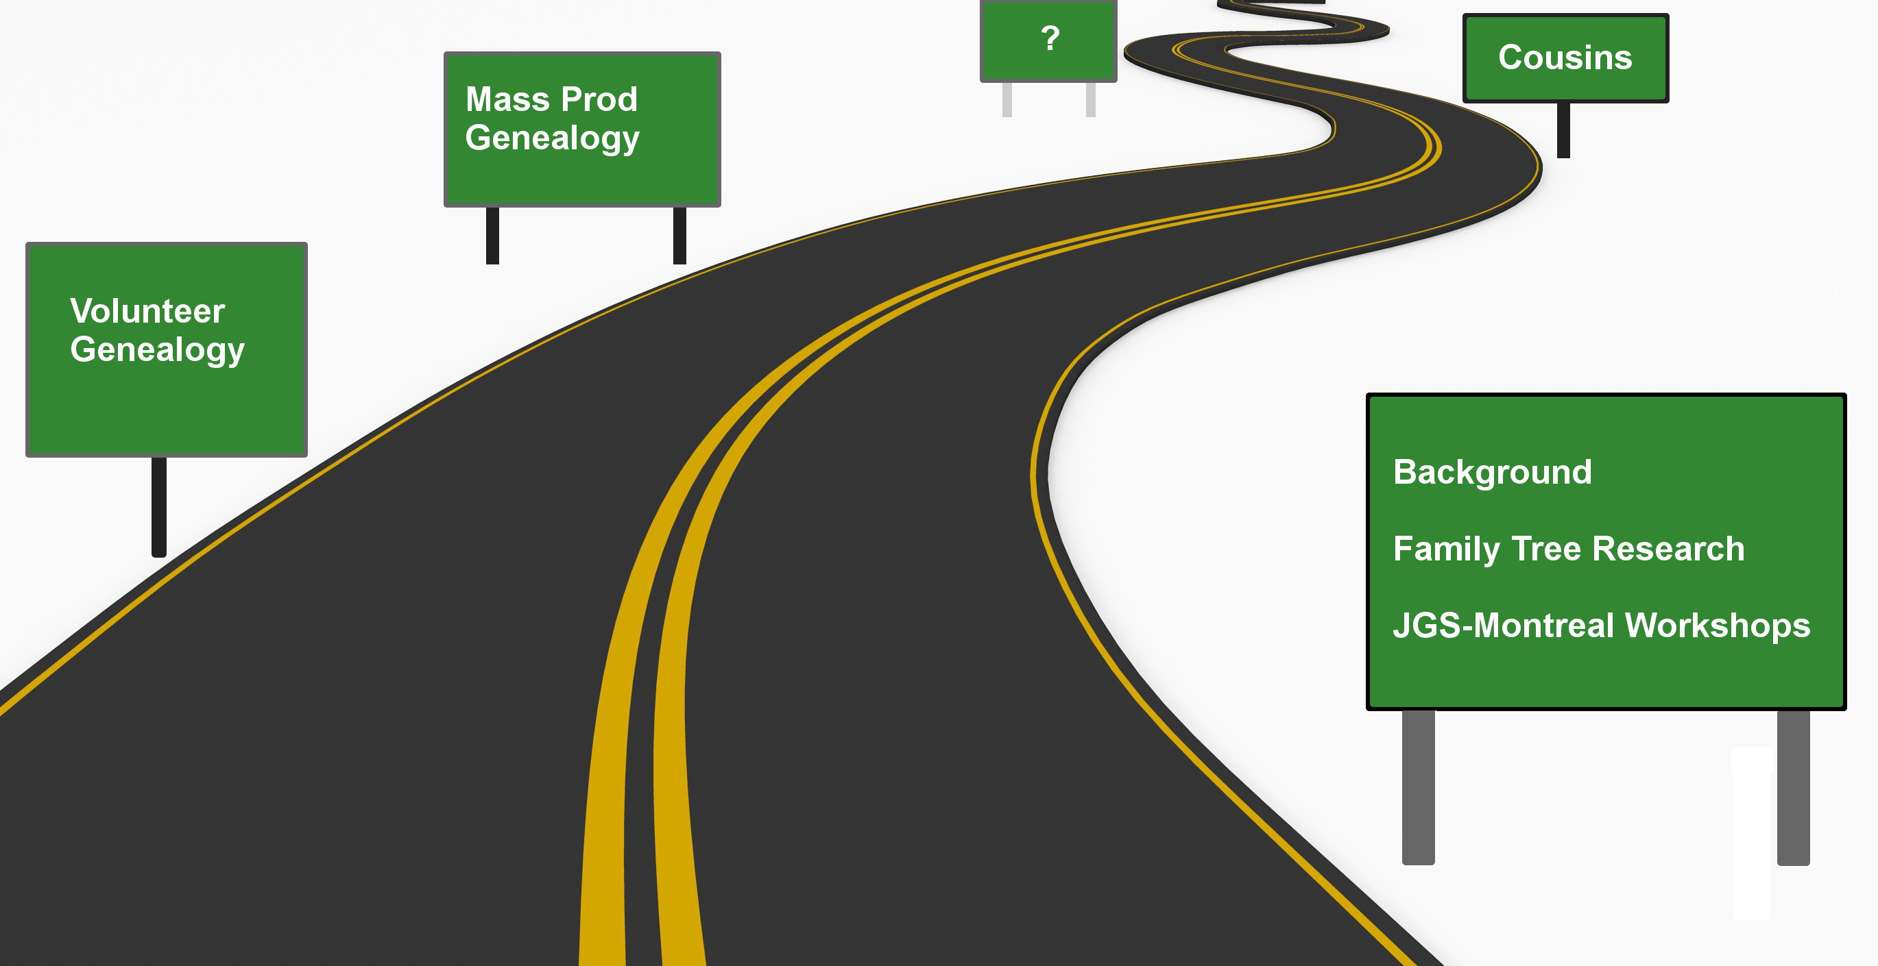
Plan for the Presentation

Slide 3
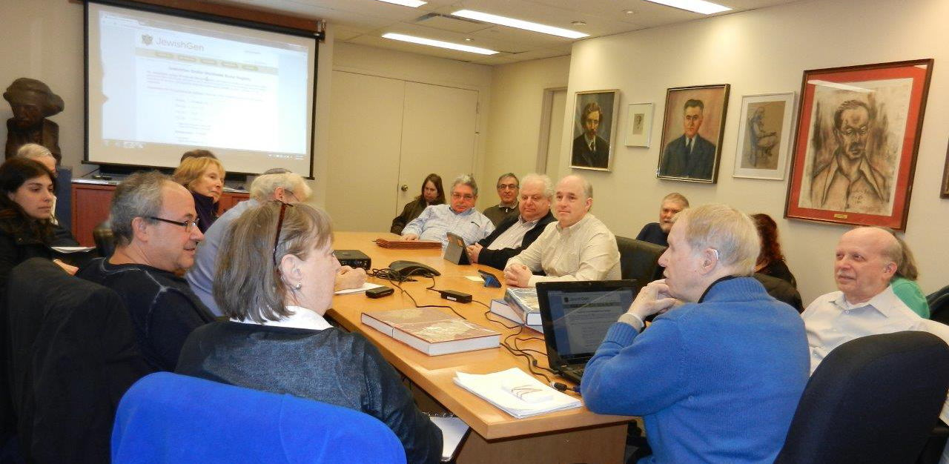
My Family Tree Research
Ancestors immigrated/naturalized 100+ years ago: Russia (Belarus, Ukraine), Romania
Afternoon with my grandmother - preserved
MyHeritage family tree, Ancestry research
JGS-Montreal Sunday Workshops

Slide 4
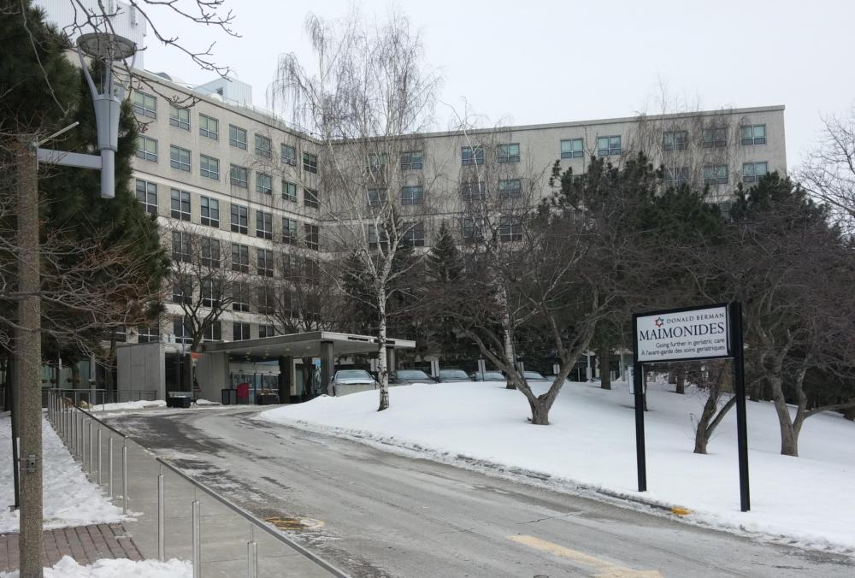
Volunteer Genealogy Sessions
Start with names, dates, places
Meet 1 hour/week, 10+ hours research
Photograph gravestones, weather permitting
Store info at Geni.com (free!)
  I set up email and "pose" as client
Deliver pictures of graves, records, ...
Started with computer, but stopped
  hard to see, even accommodated
  unavailable printouts frustrating

Slide 5
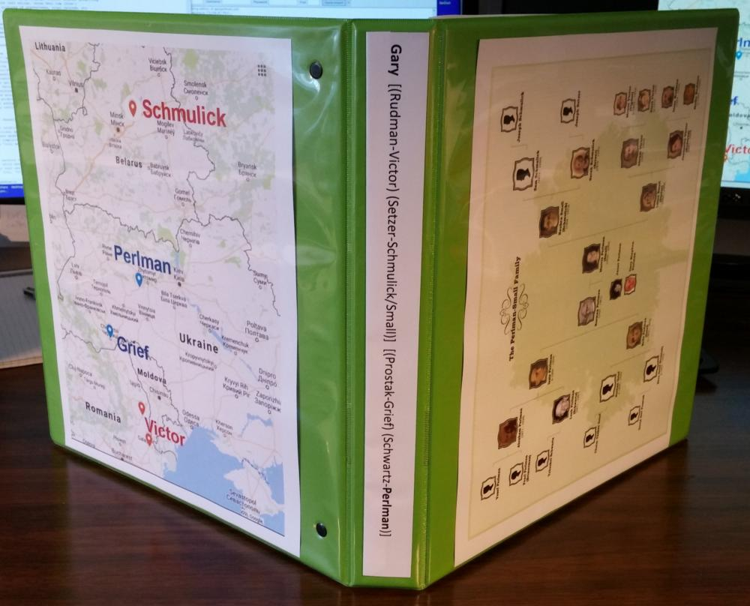
Volunteer Genealogy Products

Slide 6
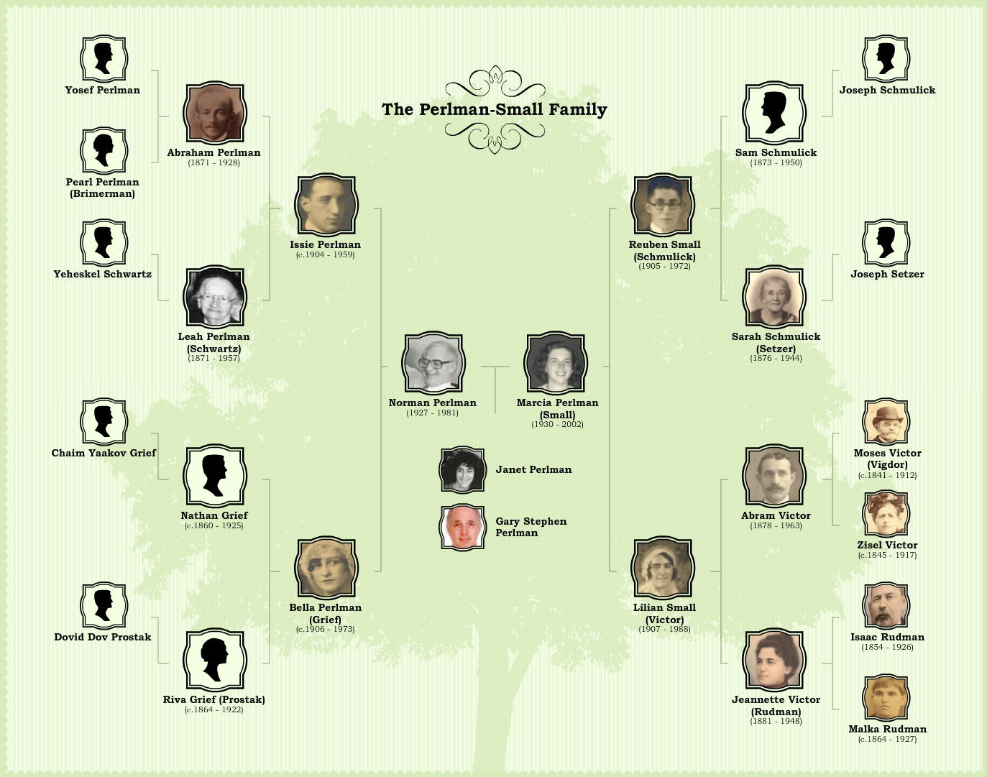
Family Tree Chart

Slide 7
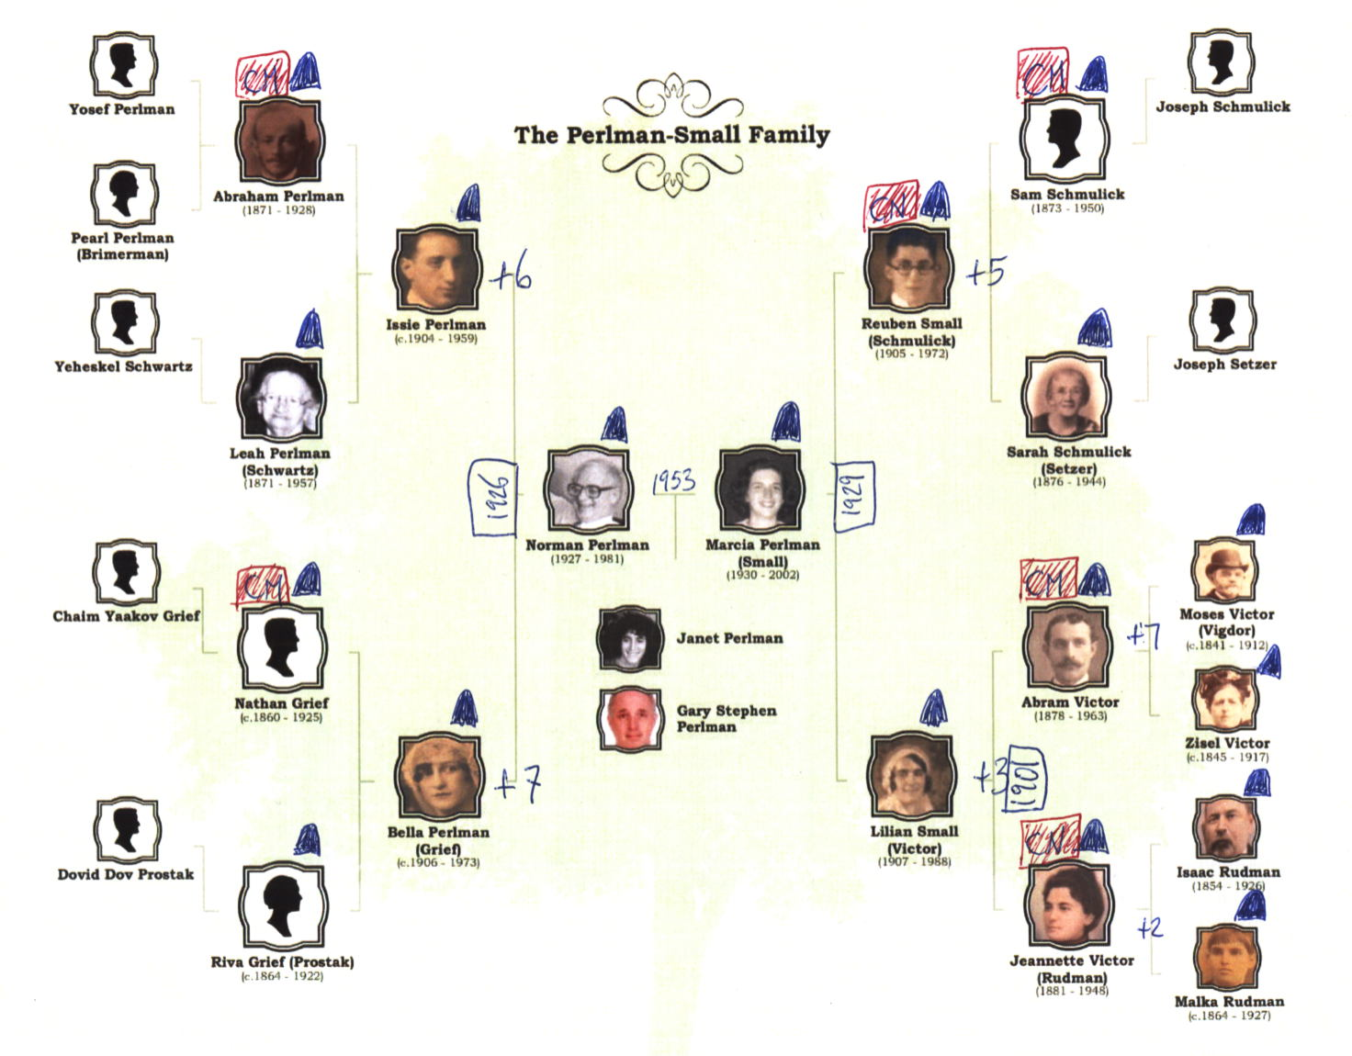
Family Tree Chart - Annotated

Slide 8
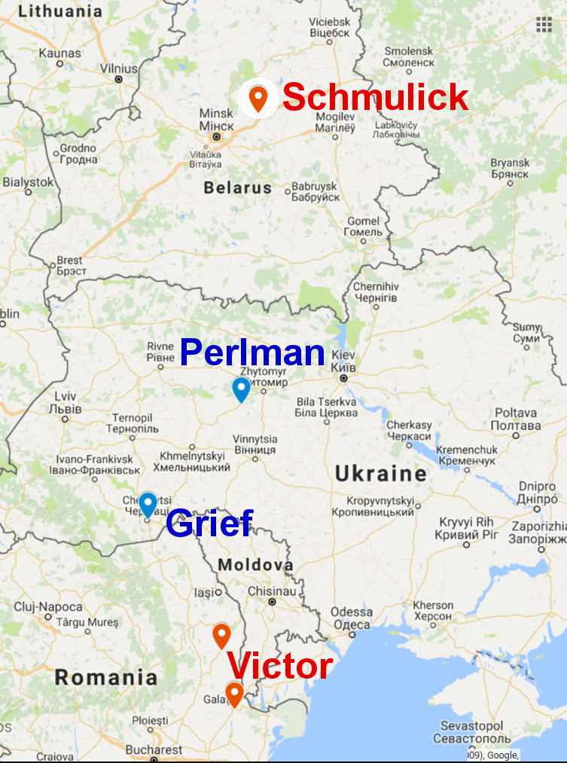
Family Origin Map

Slide 9
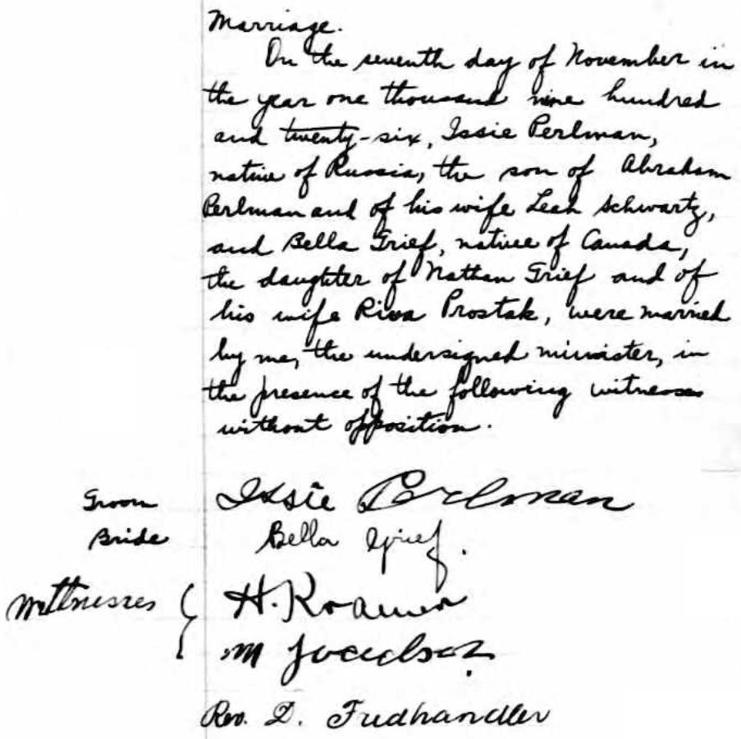
Marriage Record - Drouin

Slide 10
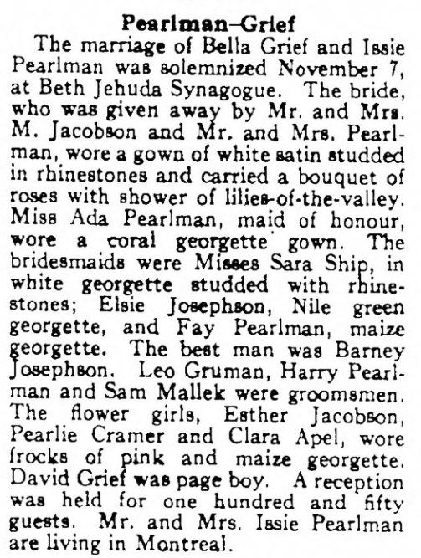
Canadian Jewish Review

Slide 11
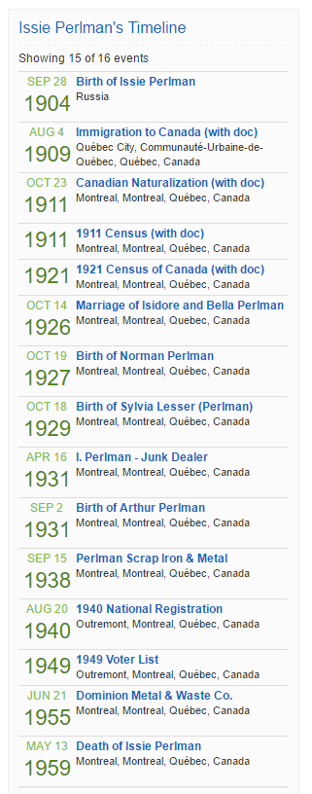
Timelines with Documents

Slide 12
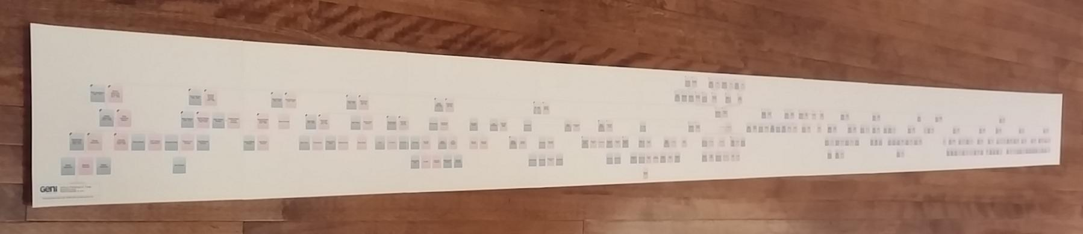
Printed Family Tree

Slide 13
Lessons Learned
No agenda - but some preferences
Client frailties (hearing, vision, coordination)
Everything clients say is valuable
Never contradict
Clients get verklempt
Recent facts hard to recall, distant past easier
Bury some details - some found, some spoken
Family involvement – variable
Keeping track is hard but crucial
Spend Pocket change on clients

Slide 14
Volunteer Genealogy Highlights
1500+ relatives found on Geni.com
  client appeared 3 times in tree, as own mother!
Scanned wedding album, tagged every person
Phone calls to Italy; email to Israel
Relatives phone, 3rd/4th cousins help
From "very small family" to "kinda small family"
Connections to my family, friends
Visits to the lunchroom

Slide 15
Volunteer Genealogy Amusements
"Who ARE you? Reveal yourself!"
"My parents owned a candy shop"
"My uncle was Peter, but we called him Passie"
"I'm not interested in his side!”
And you have a brother named Zurach?
Do you have any other names?
Your aunt was forty years older than your father
Widows in Lovell's Directory

Slide 16
Harder Lessons
Cancellations, without notice
Stopped due to child's privacy concerns
Great nephew offended by email contact
Client's ex concerned that son contacted
Half of couple not interested
Stories, labour-intensive, not of interest
Printing files, only if easy to read

Slide 17
Volunteer Genealogy Stats
12 Clients
Ages 50s-90s
All but one Jewish
Three Holocaust-related
One married couple
Two stopped early, others keep going
Two passed away, 4 shivas, once pallbearer
Documents gathered: 500

Slide 18
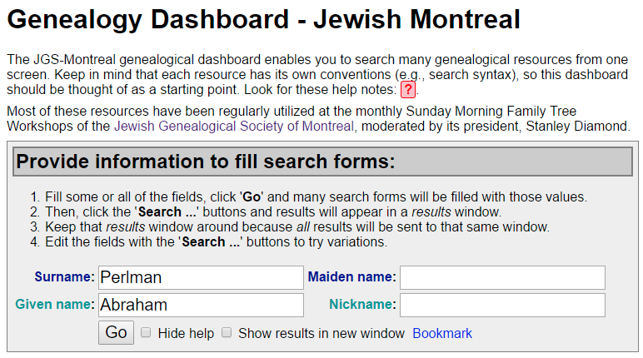
Genealogy Dashboard
Started with page of resources with links
Used my own search forms (e.g., JOWBR)
Idea: Enter name once; search many resources

Slide 19
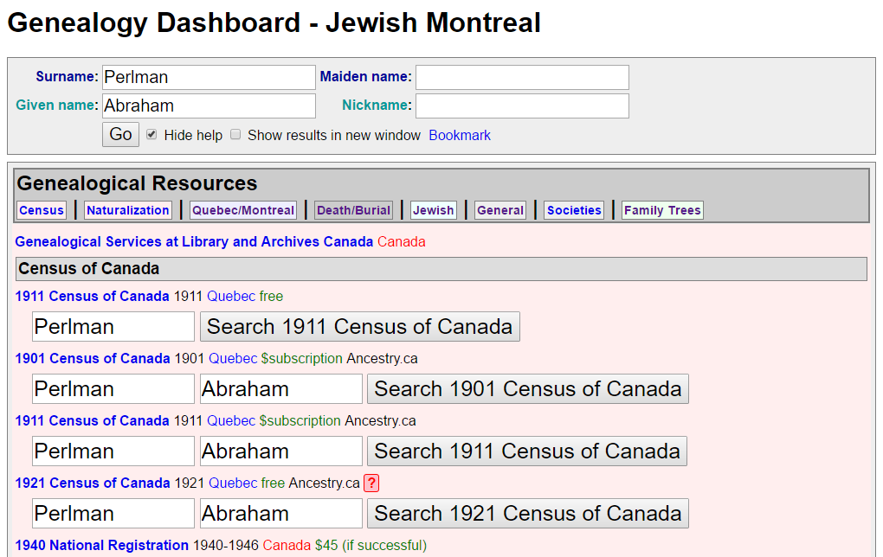
Dashboard – Filled

Slide 20
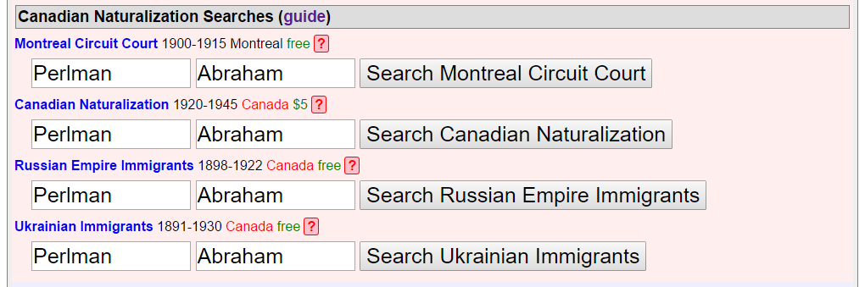
Dashboard – Naturalization
Two main sources
Guide to obtaining files

Slide 21
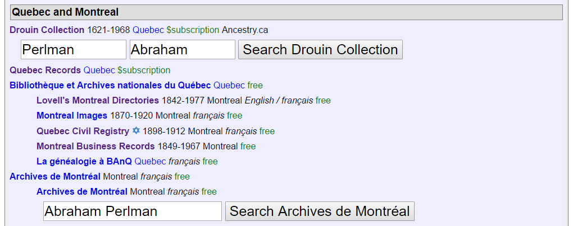
Dashboard – Quebec & Montreal

Slide 22
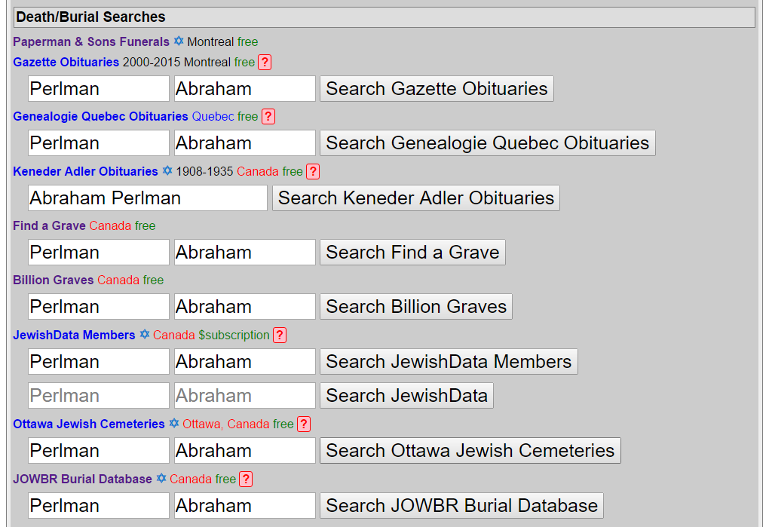
Dashboard – Death & Burial

Slide 23
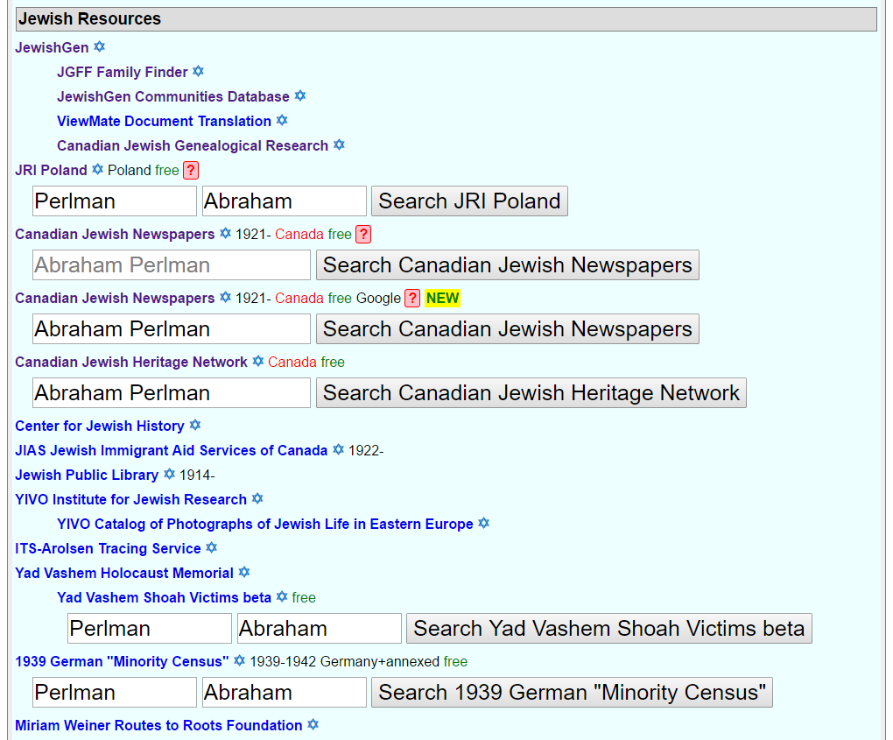
Dashboard – Jewish

Slide 24
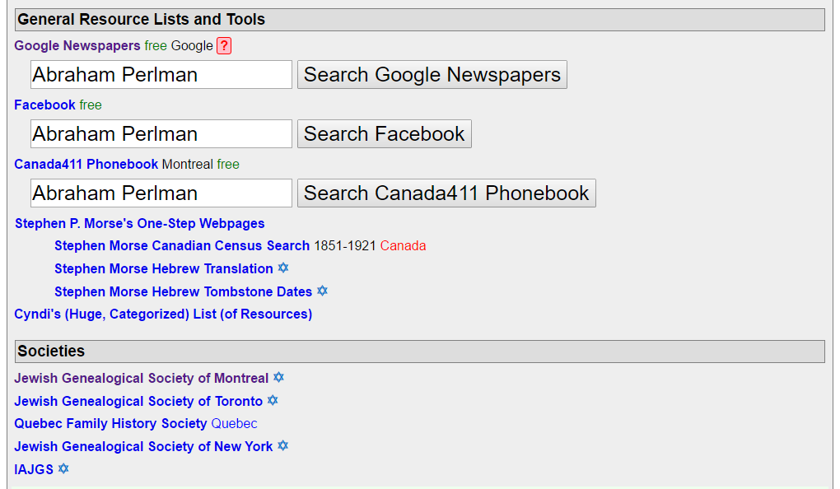
Dashboard – General

Slide 25
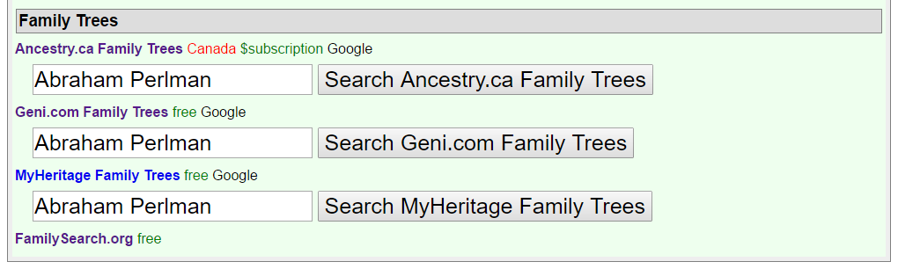
Dashboard – Family Trees
Don’t duplicate work that’s been done
Tree managers might be relatives

Slide 26
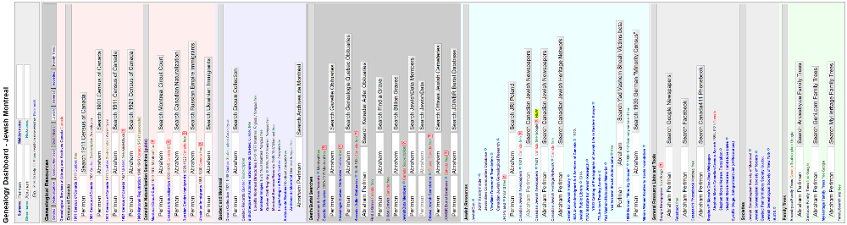
Dashboard - Complete

Slide 27
Dashboard Example – search MCC

Slide 28
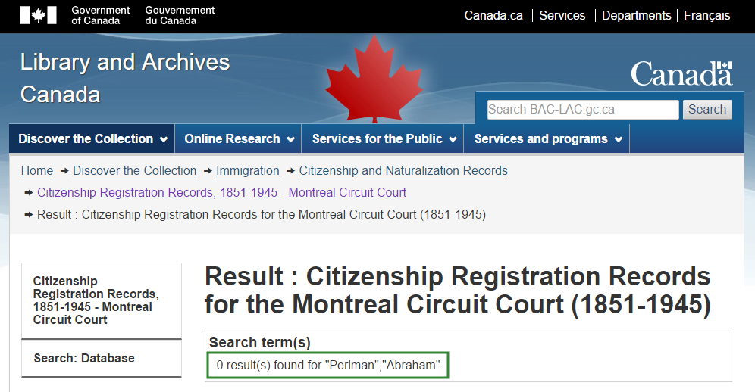
Dashboard Example – no match

Slide 29
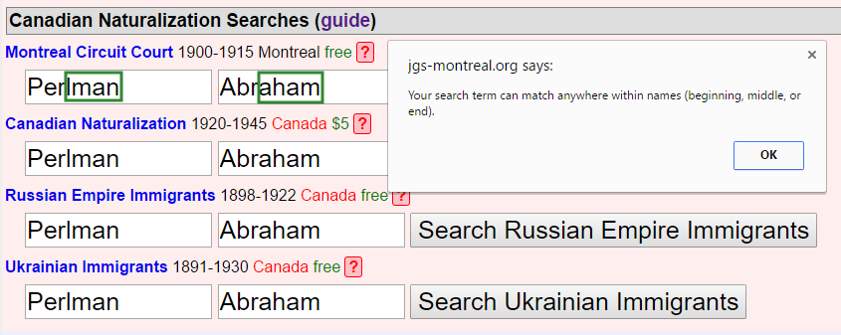
Dashboard Example – get help

Slide 30
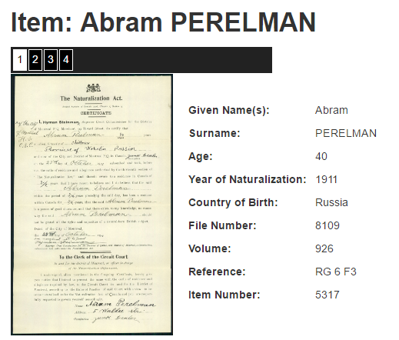
Dashboard Example – got match?

Slide 31
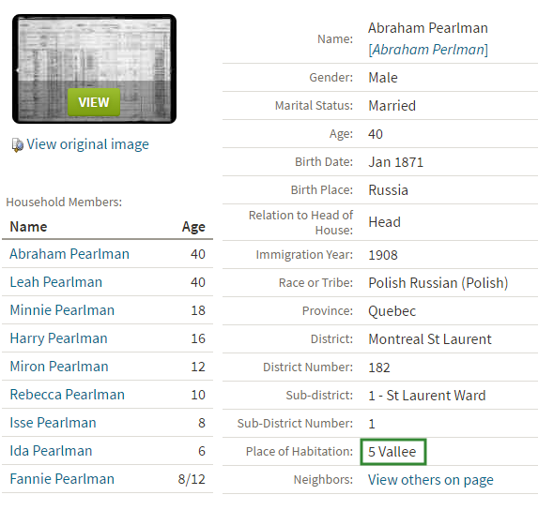
Dashboard Example – 1911 census

Slide 32
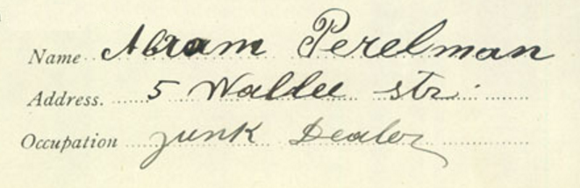
Dashboard Example – matches!

Slide 33
My Cousins’ Genealogy
Clients had better sources than my family
Gathered docs, connected with cousins
Birth/Immigration/Naturalization/Marriage/Death
Created Family Groups with stories
  grandparents - 1st cousins Perlman / Grief; Schmulick/Small / Victor
  1st cousins' grandparents Cohos/Kohos / Shoub; Elkin / Steinman; Kwechansky / Taller / Schnapp
  2nd cousins' grandparents Lupovich / Safran; Bindman / Ship
  great-grandparents - 3rd cousins Perelman; Rudman; Vigdor

Slide 34
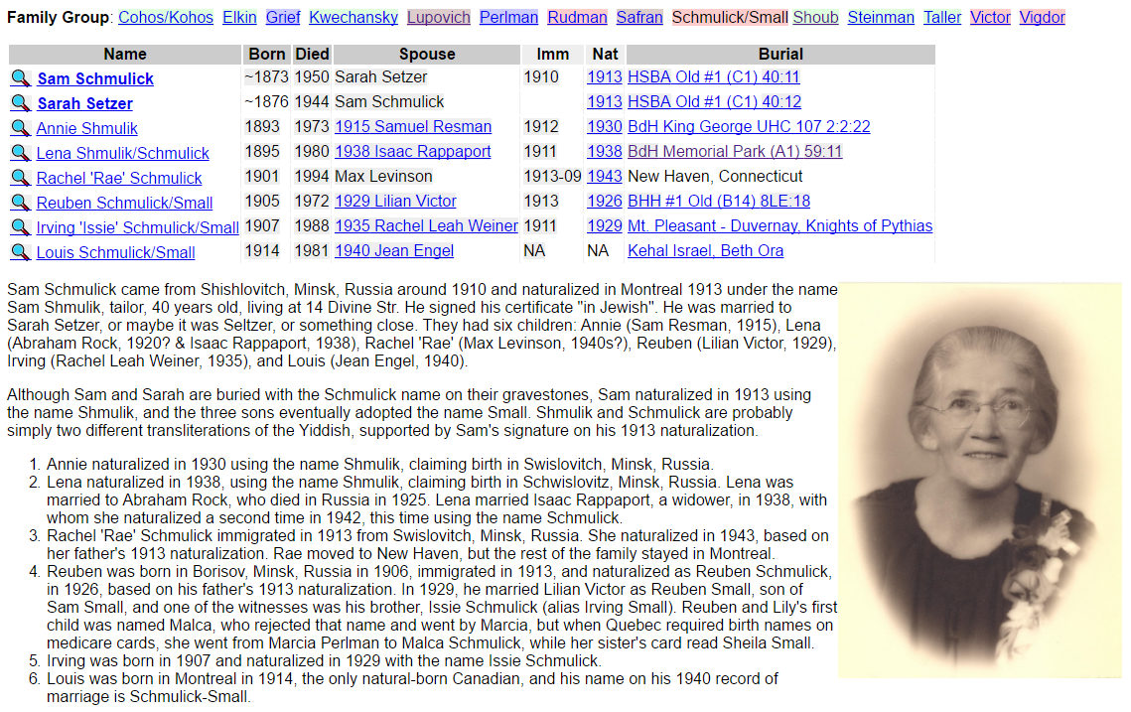
Family Group + Immigration Story

Slide 35
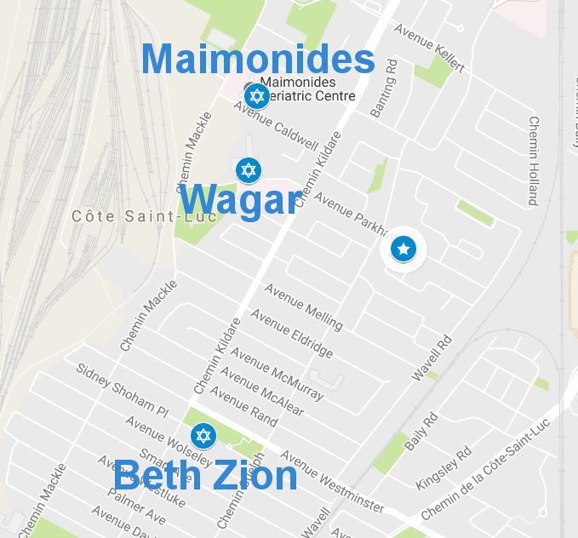
Synergy in Cote Saint-Luc

Slide 36
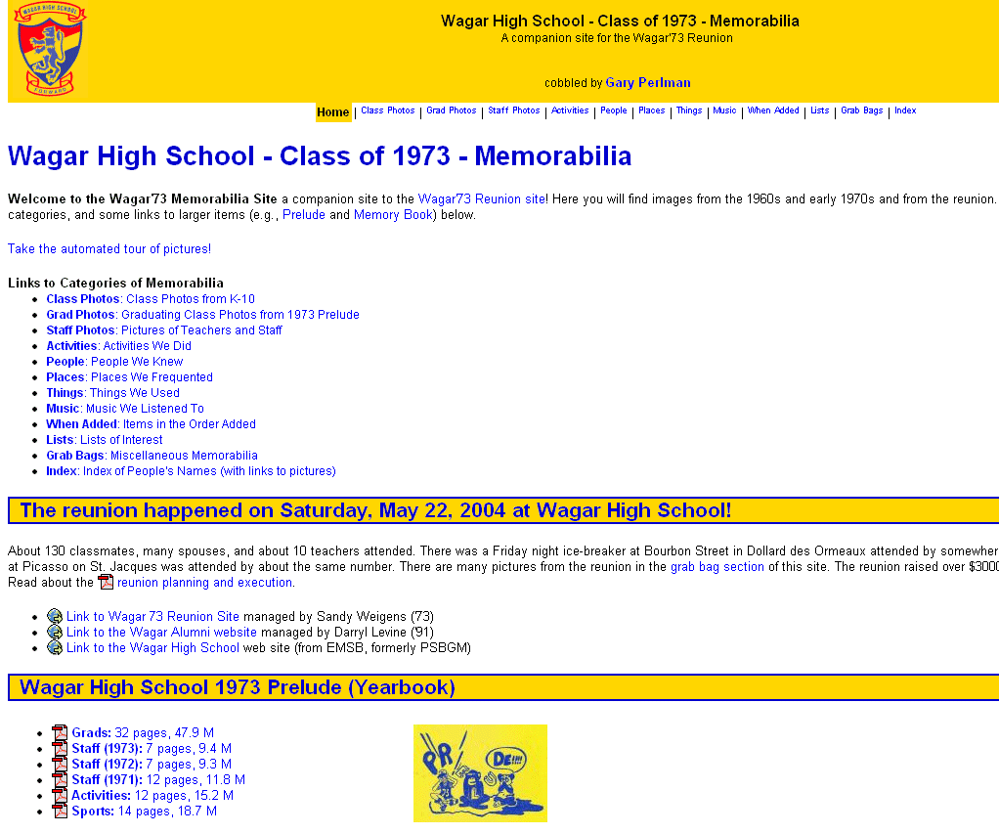
Synergy - Wagar 2004 Reunion

Slide 37
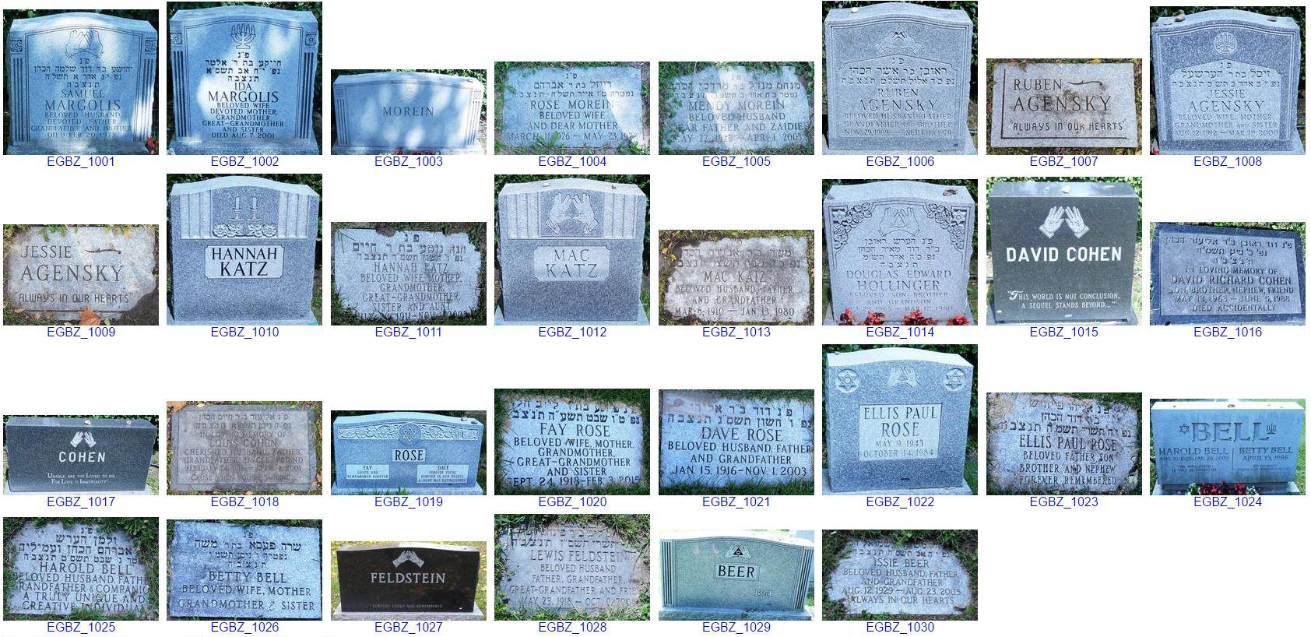
Synergy – Beth Zion

Slide 38

Synergy – Wagar Yearbooks

Slide 39
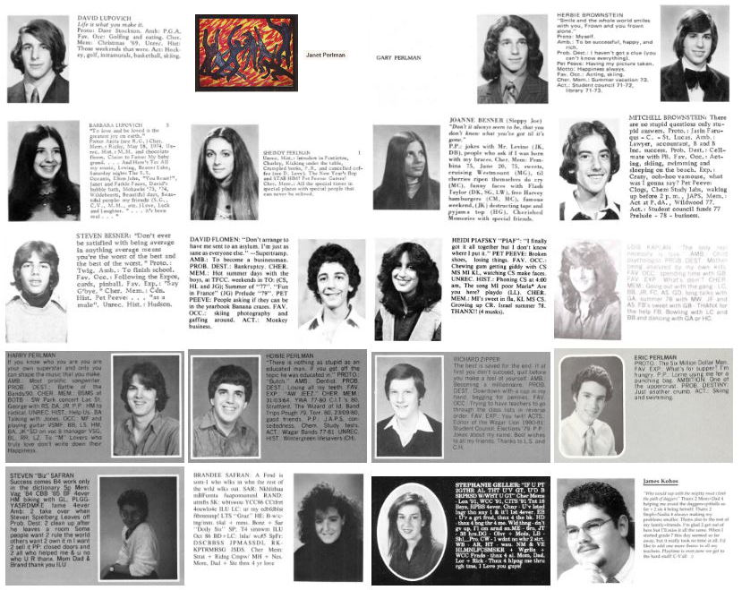
Synergy – Relatives at Wagar

Slide 40
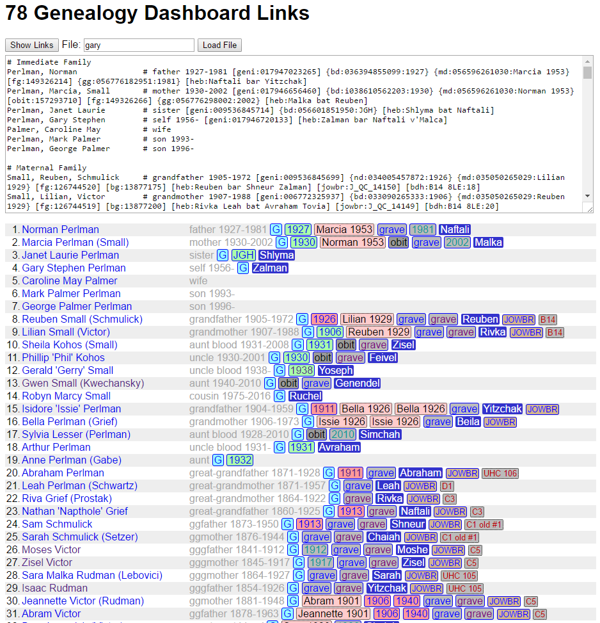
Next Generation Tools

Slide 41
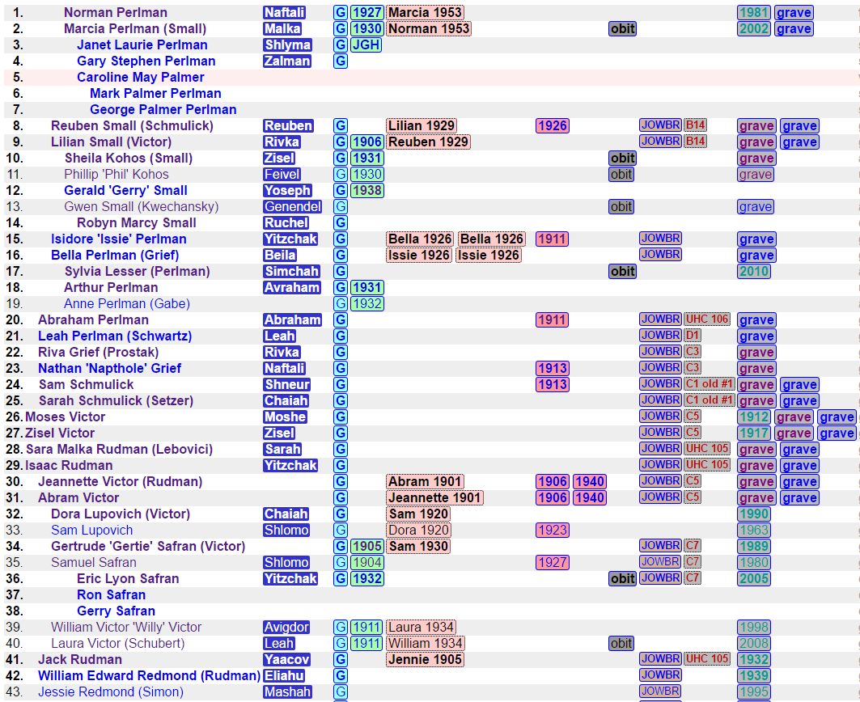
Indented Tabular View

Slide 42
Thank You! Questions?
Gary Perlman, gary@perlman.ca
More details: Annotated Slides with Links
Acknowledgments:
  Donald Berman Maimonides Geriatric Center
    Patti Derstenfeld, Kim Weippert
  JGS of Montreal
    Stanley Diamond, Merle Kastner
  Wagar High School Volunteers

